Slide 1
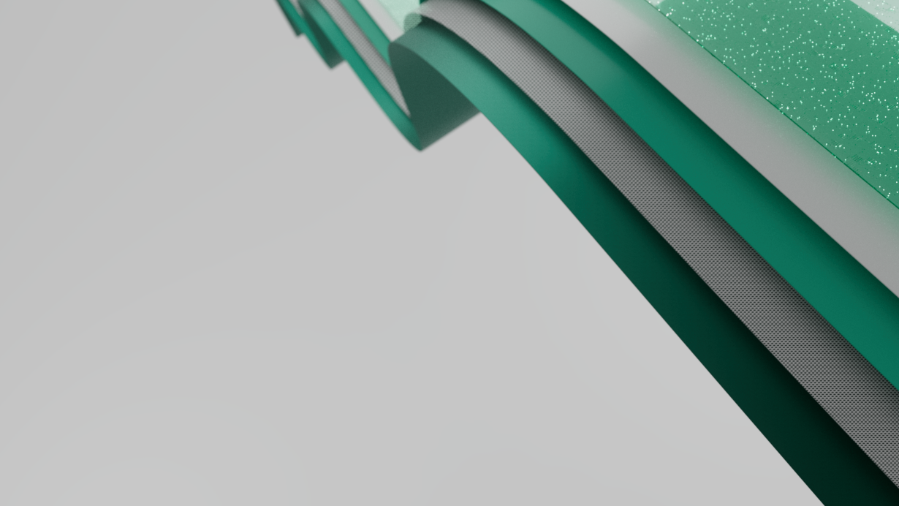

Microsoft Fabric Medallion architecture demo

Slide 2
Agenda
Fabric – Quick Overview
Medallion architecture
Demo
Setting the stage: NYC Taxi company
Define metrics for a business question
Deploy Bronze, Silver and Gold data layers
Build PowerBI report providing insights
Notes:
What is Fabric
End to End Analytics Platform
Key Points
One Lake
Single source of truth
PowerBI Copilot
Pricing
How to set up environment

Slide 3

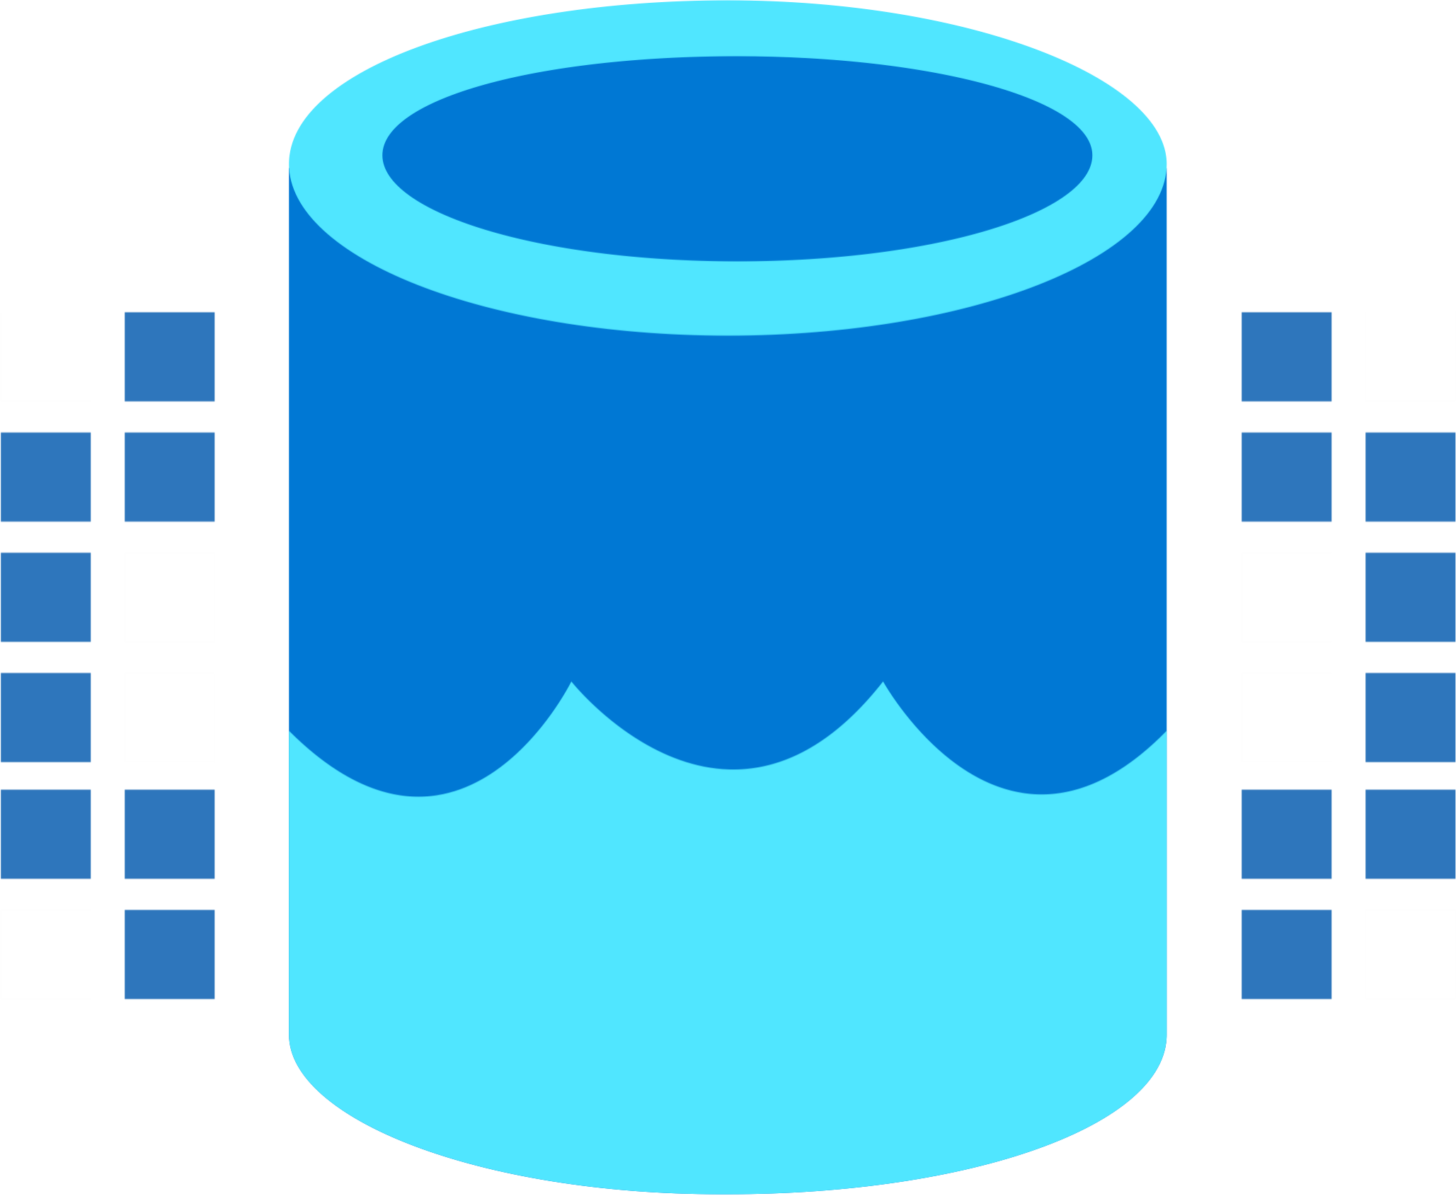
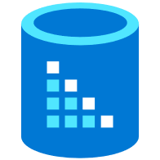

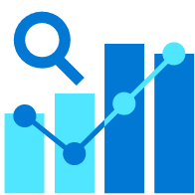

Microsoft Fabric
Data Integration
Data Lake
Spark Engines
Data
Warehouse
Real Time Analytics
Data
Science
Business
Intelligence
Governance
Unified analytics fabric
End-to-end analytics data fabric
From the data lake to the business user
Notes:
Today, with Microsoft Fabric, we go from a collection of products to a Unified Analytics fabric that brings end-to-end analytics from the data lake to the business user
Microsoft Fabric is an all-in-one analytics solution for enterprises that covers everything from data movement to data science, Real-Time Analytics, and business intelligence. It offers a comprehensive suite of services, including data lake, data engineering, and data integration, all in one place.
With Fabric, you don't need to piece together different services from multiple vendors. Instead, you can enjoy a highly integrated, end-to-end, and easy-to-use product that is designed to simplify your analytics needs.
The platform is built on a foundation of Software as a Service (SaaS) model, which takes simplicity and integration to a whole new level.

Slide 4
Medallion Architecture
.
Bronze
Ingest data in its most raw format to maintain the original state of the data. Contains a full, unprocessed history.
Silver
A validated and enriched version of the data that can be trusted by downstream systems. Uses a standardized data format.
Gold
Refined and aggregated data used to power purpose-built solutions like a data warehouse, API, or regularly generated report.
Notes:
Bronze – we just bring the data in raw format close to our processing compute.
Silver section – where will do the cleanup, standartising data formats, add columns, drop columns etc.
Gold Section is a curated section where data serves some purpose.

Slide 5
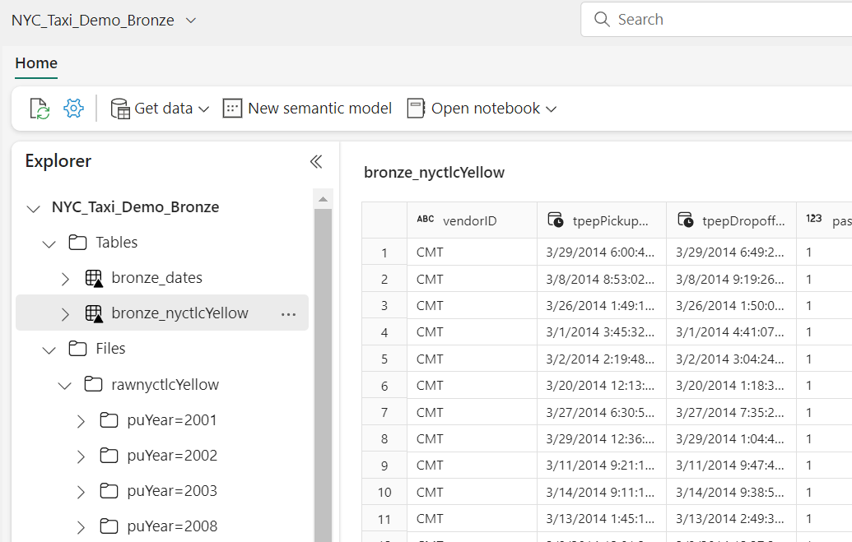
Bronze in Fabric
\Files – place for Bronze layer
\Tables – for Silver and Gold
Notes:
Delta tables are schema abstractions over data files that are stored in Delta format. For each table, the lakehouse stores a folder containing Parquet data files and a _delta_Log folder in which transaction details are logged in JSON format. On the screen Delta Tables are marked with black triangle
The benefits of using Delta tables include:
Relational tables that support querying and data modification. With Apache Spark, you can store data in Delta tables that support CRUD (create, read, update, and delete) operations. In other words, you can select, insert, update, and delete rows of data in the same way you would in a relational database system.
Support for ACID transactions. Relational databases are designed to support transactional data modifications that provide atomicity (transactions complete as a single unit of work), consistency (transactions leave the database in a consistent state), isolation (in-process transactions can't interfere with one another), and durability (when a transaction completes, the changes it made are persisted). Delta Lake brings this same transactional support to Spark by implementing a transaction log and enforcing serializable isolation for concurrent operations.
Data versioning and time travel. Because all transactions are logged in the transaction log, you can track multiple versions of each table row and even use the time travel feature to retrieve a previous version of a row in a query.
Support for batch and streaming data. While most relational databases include tables that store static data, Spark includes native support for streaming data through the Spark Structured Streaming API. Delta Lake tables can be used as both sinks (destinations) and sources for streaming data.
Standard formats and interoperability. The underlying data for Delta tables is stored in Parquet format, which is commonly used in data lake ingestion pipelines. Additionally, you can use the SQL Endpoint for the Microsoft Fabric lakehouse to query Delta tables in SQL.

Slide 6
Datasets KPI and Metrics
User/Audience | Dashboard/Area | Key Questions | KPIs/Measures | View/Filter By | Data Sources Used
Individuals considering applying for a NYC Taxi Medallion | Fare and Tip Overview | How many trips are done in average each date across/in each area of NYC? Which locations have the highest average fare/tip? Is it better to do lots of short trips or fewer long ones? What time of day is it best to take trips? Is the trip fare and tips higher with multiple passengers compared to a single passenger? | # Trips Average Fares Average Tip Amount Total Fare Amount including/excluding tips | Trip Duration Time of Day (Lunchtime/early morning, etc) Single vs multiple passengers | Yellow and Green Taxi datasets from Azure Public Datasets

Slide 7
NYC Dataset
Yellow and green taxi trip records, captured from 2009 onwards by NYC Taxi and Limousine Commission
Fields:
pick-up and drop-off dates/times,
pick-up and drop-off locations,
trip distances,
itemized fares,
rate types,
payment types,
driver-reported passenger counts.
Sizing:
Bronze: 105Gb in Size
Gold: 25 Gb (*)
Notes:
(*)
For the purpose of report we are removing the following:
Duplicate data,
yellow taxi cabs only (there are others types in the dataset as well)
Only trips with actual passenger counts (could be data collection errors, misreporting, etc)
https://www.nyc.gov/site/tlc/about/tlc-trip-record-data.page

Slide 8
PowerBI Copilot

Slide 9
https://www.youtube.com/watch?v=wr__6tM5U6I
Notes:
https://www.youtube.com/watch?v=wr__6tM5U6I

Slide 10
Enable Fabric

Slide 11
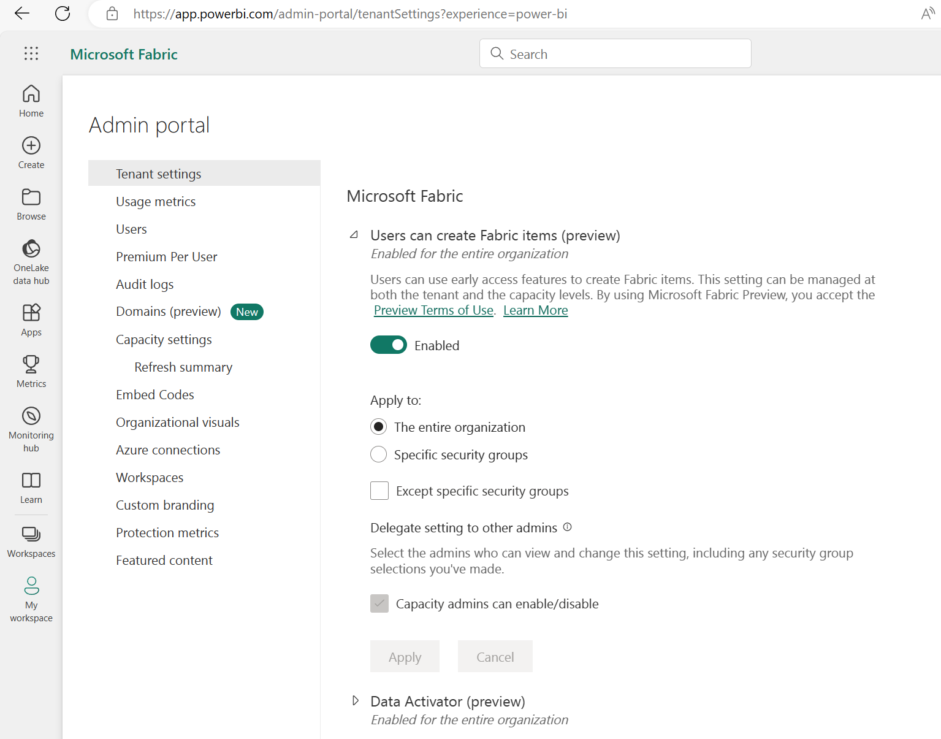
Fabric
Administrator settings
Enable Fabric functionality for all users or per security group

Slide 12
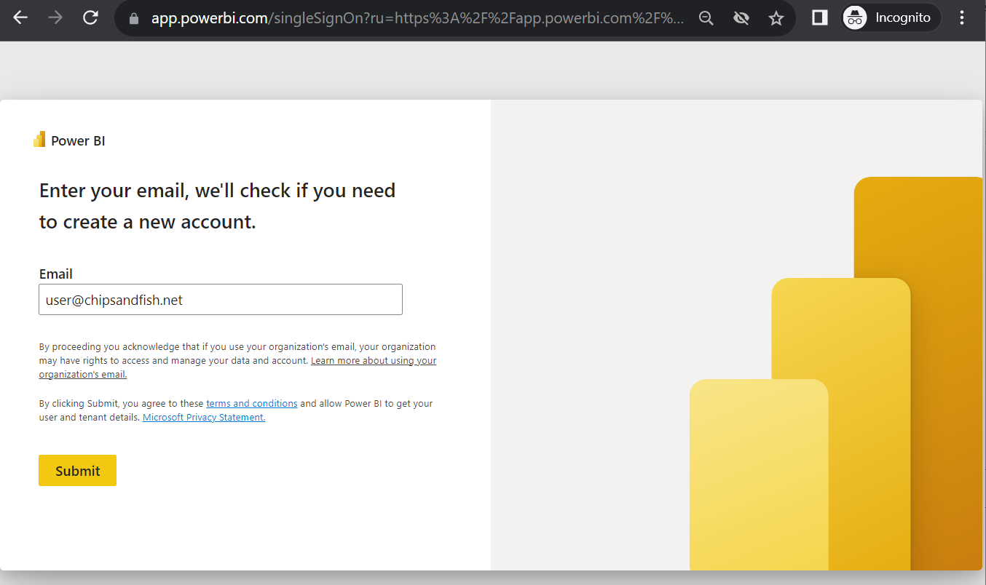
Fabric
User Sign Up experience
Navigate to
https://app.powerbi.com

Slide 13
Other resources

Slide 14
Microsoft Fabric Pricing
Aka.ms/FabricLicensing
Notes:
https://learn.microsoft.com/en-us/fabric/enterprise/licenses

